Slide 1
University of Texas at Arlington
MACHINE LEARNING
(CSE-6363-004)
Topic –
Computer Vision – Deep Learning
Traditional Object Detection vs Deep Learning Object Detection
Project Final Presentation
Group - 17
Neil Nahar - 1002067268
Sufyan Ali – 1001958007
Sakshi - 1001993702

Slide 2
Timeline:
Step 1: Implemented Haar-Cascade Classifier and summarize its pros and cons.
Step 2: Implemented YoloV5 Algorithm and summarize its pros and cons.
Step 3: Implement Mask-RCNN and summarize its pros and cons
Step 4: Compare Mask-RCNN and YoloV5 performance
Step 5: Create a detailed report by comparing them using a second dataset.
For reference:
Yolov5 and Mask-RCNN model are pre-trained on the Coco Dataset
We further validated YoloV5 on Road Sign Dataset from Kaggle
To compare both models we created a custom dataset by randomly sampling Coco Dataset

Slide 3
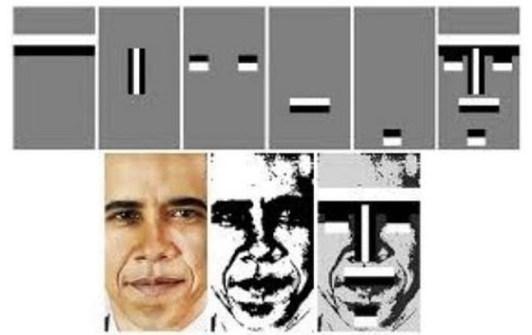
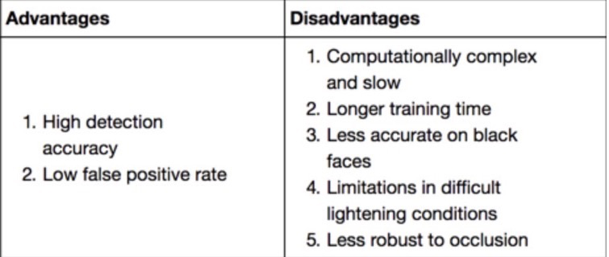
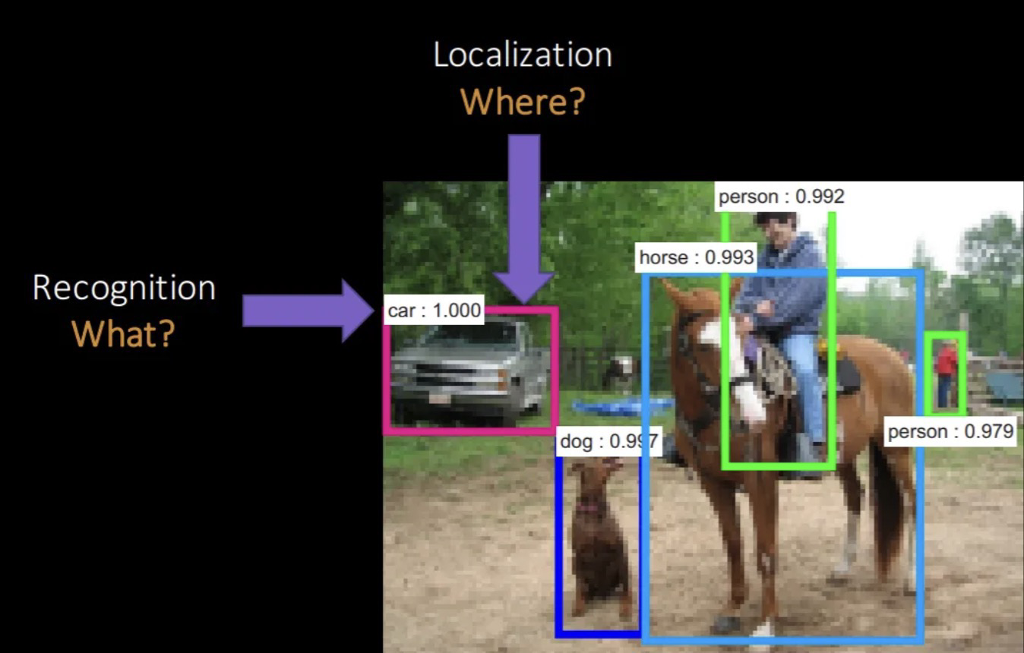
Haar Cascade Face recognition with OpenCV: Improved model accuracy by adding more layers of features detection
Does not work on Coco Dataset
Advantages | Disadvantages
High Accuracy | Hardware Requirements: YOLOv5 requires powerful hardware for training and inference, which may limit its accessibility to some users.
Fast object detection | Limited Accuracy on Small Objects: YOLOv5 may have lower accuracy when detecting small objects or objects with low contrast or blurry edges.
Simple and easy-to-understand | Training Time: Training YOLOv5 can take a long time and require large amounts of data and computational resources.
Yolo(You only look once): Object Detection as Regression Problem
Works well on Coco Dataset.
Output: Bounding Box coordinates and Class Probabilities

Slide 4
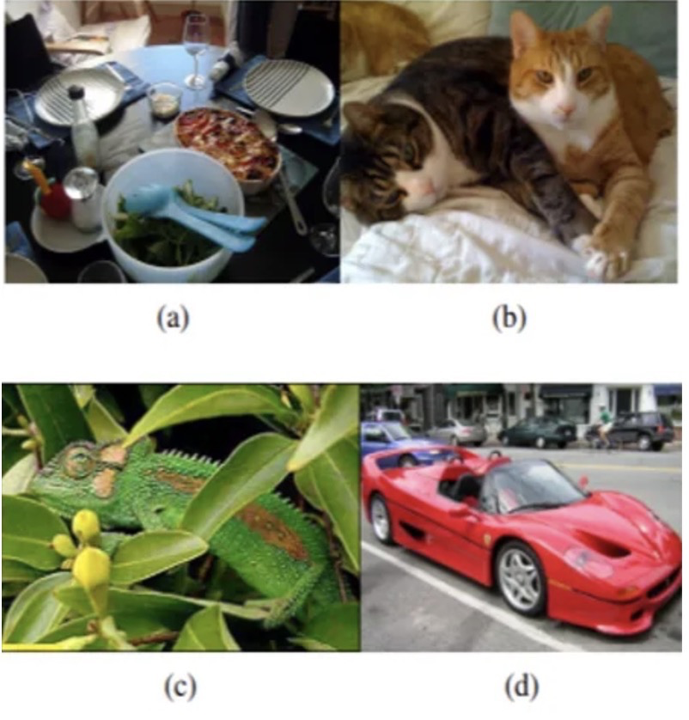
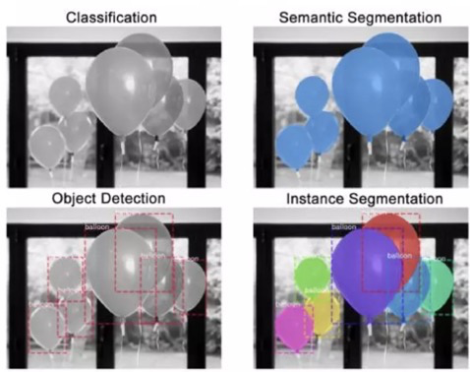
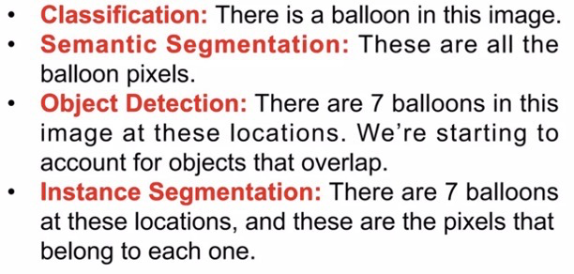
Instance Segmentation:
Aims to predict object class labels and perform pixel-wise comparison.
Figure(a), spoons, bowls are in different scales.
Figure(b), kittens are distinguishable based on colors and not texture.
Figure(c), Chameleon is distinguishable by texture, but not color.
Figure(d), Wheels are part of the car, but not similar in color or texture. They are part of an enclosure.
Regions in an image can be identified by
varying colors
varying scales
varying textures
varying enclosures

Slide 5
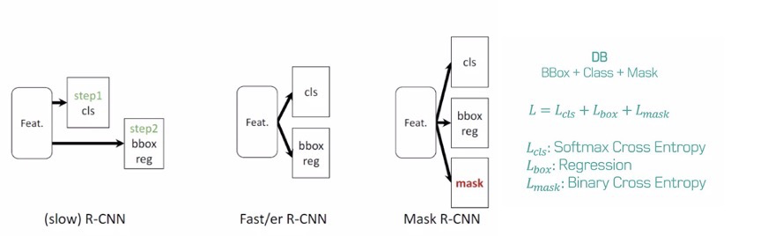
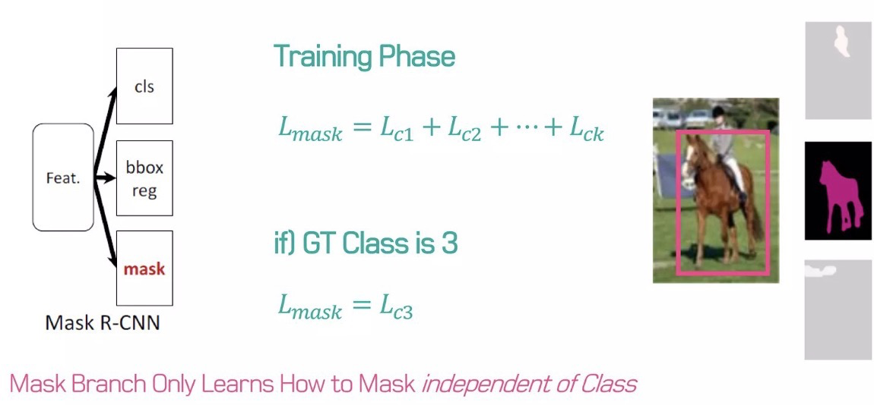
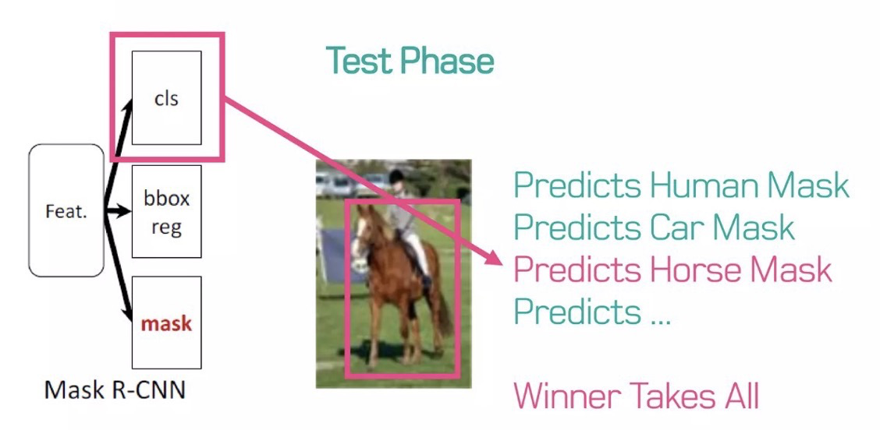

Slide 6
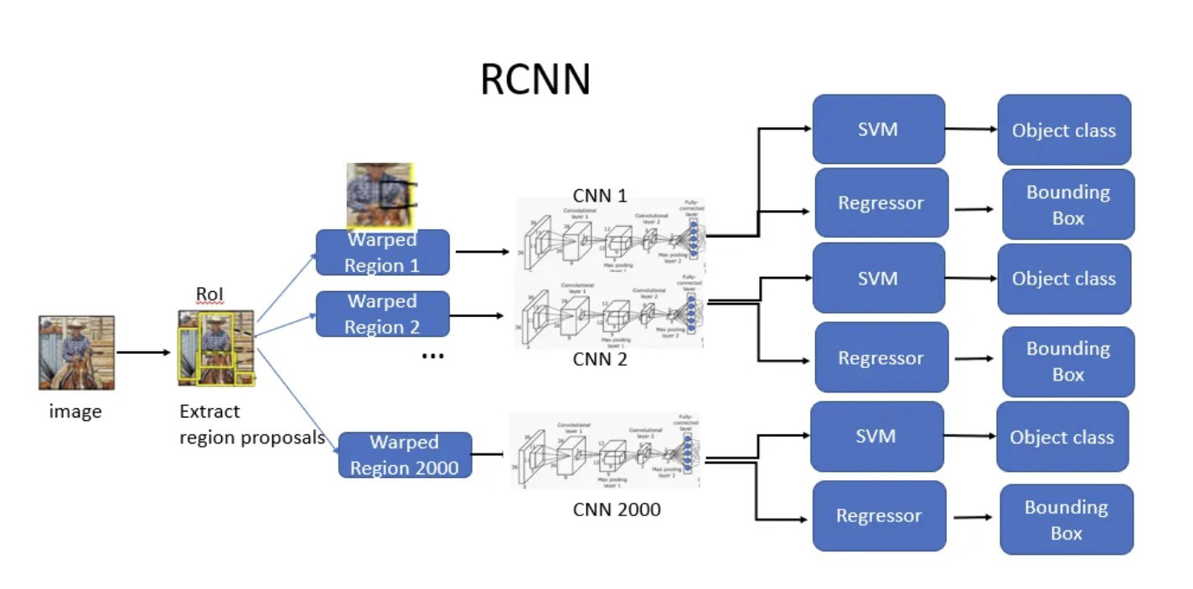
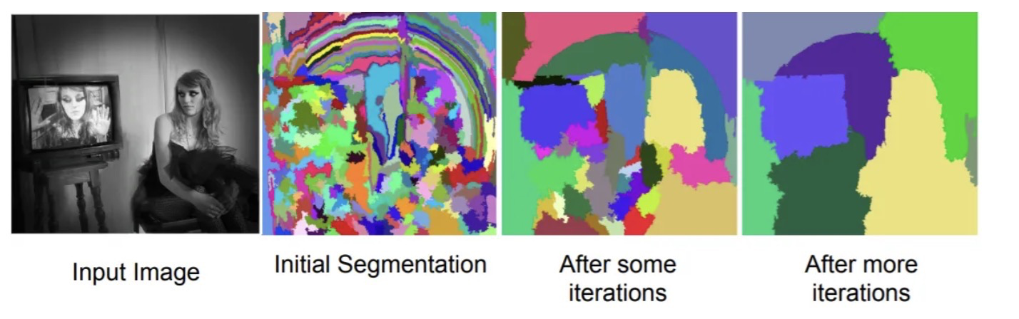
R-CNN: What is a regional proposal?
What makes training slow and expensive in R-CNN ?
Extract 2000 regions for every image based on selective search.
Extracting features using CNN for every image region. For N images, we will have N*2000 CNN features.
R-CNN’s Object detection uses three models:
•CNN for feature extraction
•Linear SVM classifier for identifying objects
•Regression model for tightening the bounding boxes
Regional proposals are a way to generate a set of candidate object locations that are likely to contain objects. This reduces the search space for object detection algorithms, making them more efficient.
Selective search Algorithm to generate regions for object locations
Step 1: Generate initial sub-segmentation.
Step 2: Recursively combine similar regions into larger ones.

Slide 7
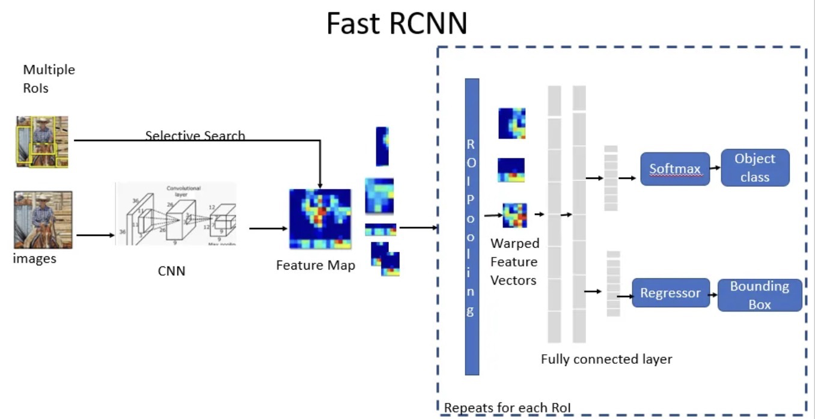
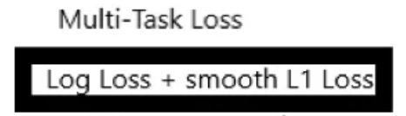
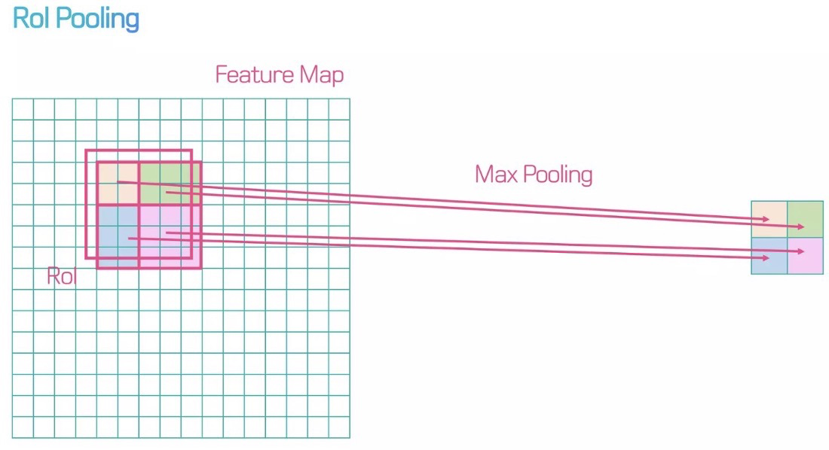
Fast RCNN:
Fast R-CNN uses a single deep ConvNet to extract features for the entire image once
ROI(Region of Interest) for the image using selective search.
ROI layer extracts a fixed-length feature vector from the feature map for each object proposal.
Fully Connected layers(FC) needs fixed-size input. Hence, we use ROI Pooling layer to warp the patches of the feature maps for object detection to a fixed size.
ROI pooling layer is then fed into the FC for classification as well as localization.
RoI pooling layer uses max pooling. It converts features inside any valid region of interest into a small feature map.

Slide 8
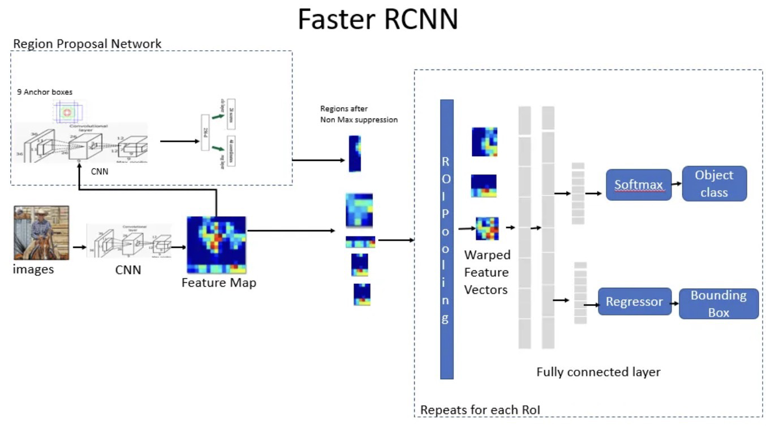
Faster RCNN:
Faster R-CNN used RPN(Region Proposal Network) along with Fast R-CNN for multiple image classification, detection and segmentation.
Region Proposal Network (RPN):
The RPN operates on a feature map produced by a shared convolutional backbone network, which is typically a pre-trained network like VGG, ResNet, or MobileNet.
The RPN generates a set of anchors, which are fixed-size rectangular boxes with different aspect ratios and scales, that are centered at every pixel in the feature map.
For each anchor, the RPN predicts two scores: the probability that the anchor contains an object (objectness score), and the coordinates of a bounding box that tightly encloses the object (regression score).

Slide 9
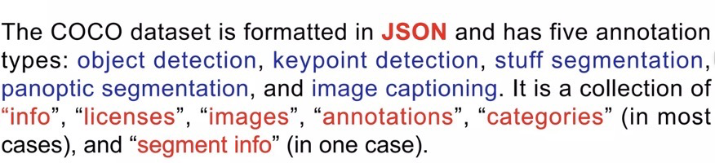
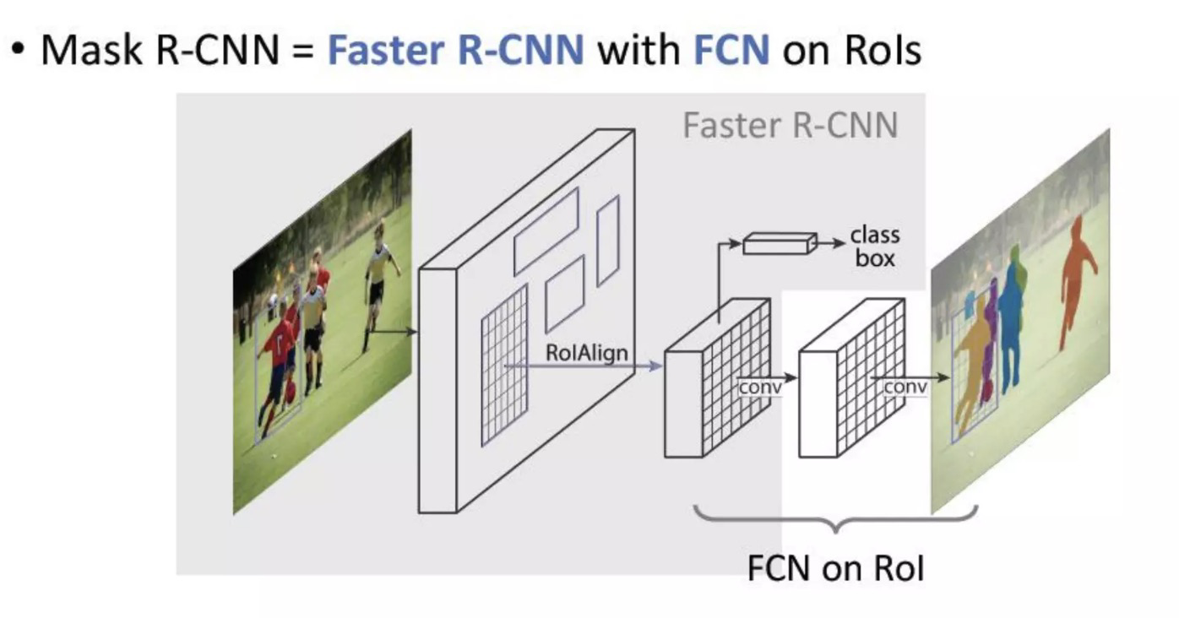
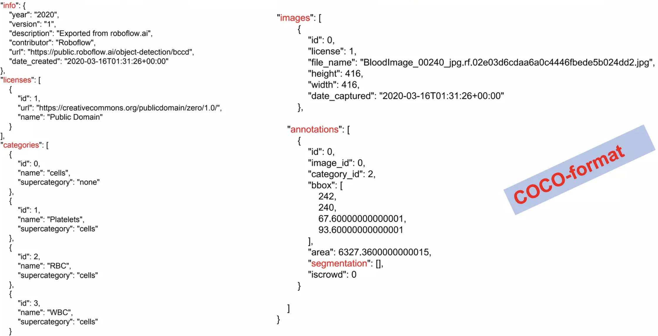
Mask R-CNN on Coco Dataset:
Mask R-CNN generates:
A set of object-bounding boxes, each with an associated class label and confidence score.
Class probabilities
Bounding box regression
Instance segmentation masks

Slide 10
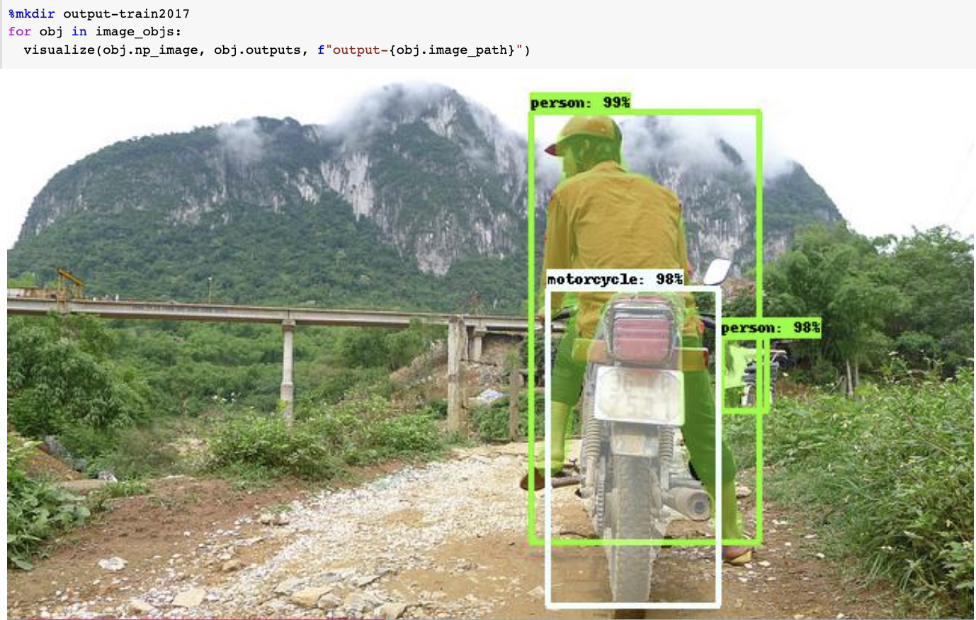
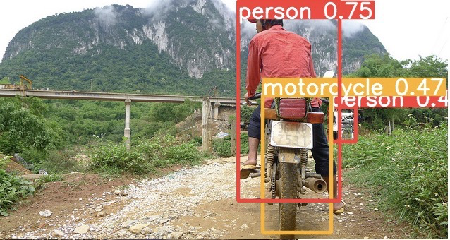
Experiment: Yolo vs Mask-RCNN
Yolo performance
Mask-RCNN performance

Slide 11
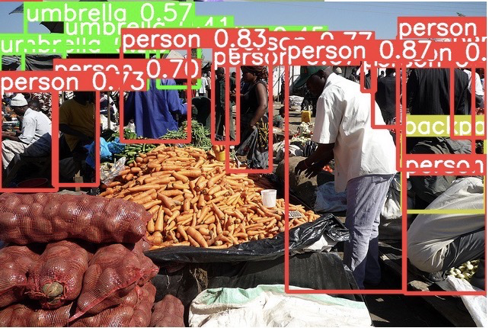
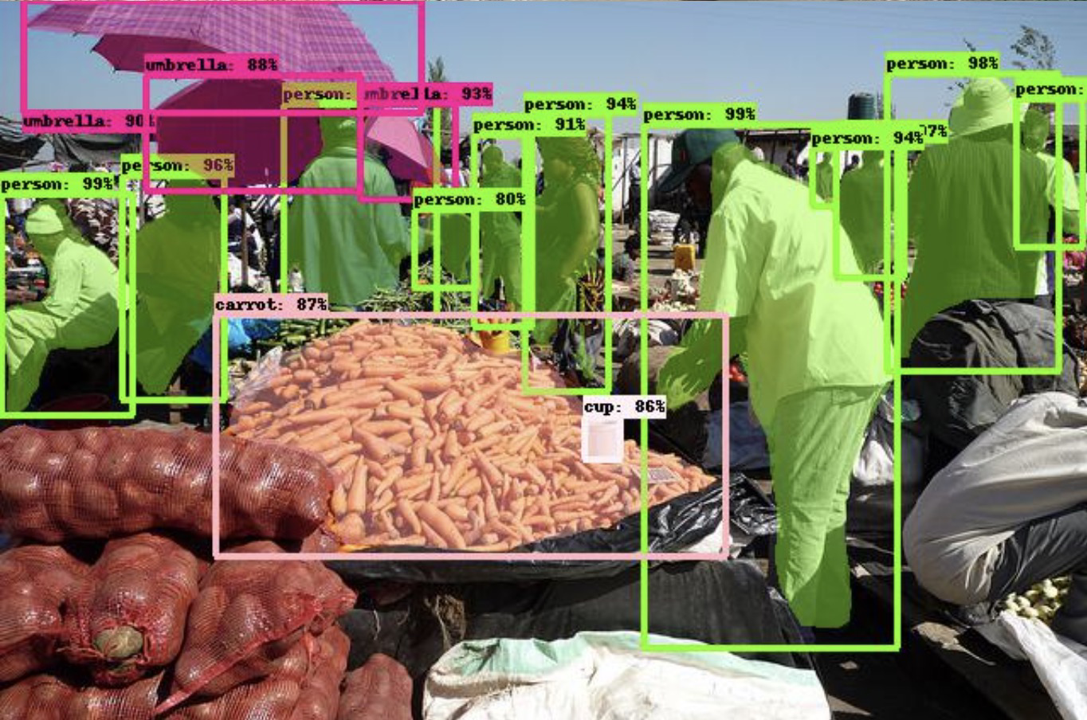
Experiment: Yolo vs Mask-RCNN
Yolo performance
Mask-RCNN performance

Slide 12
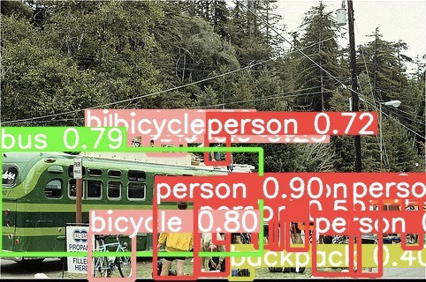
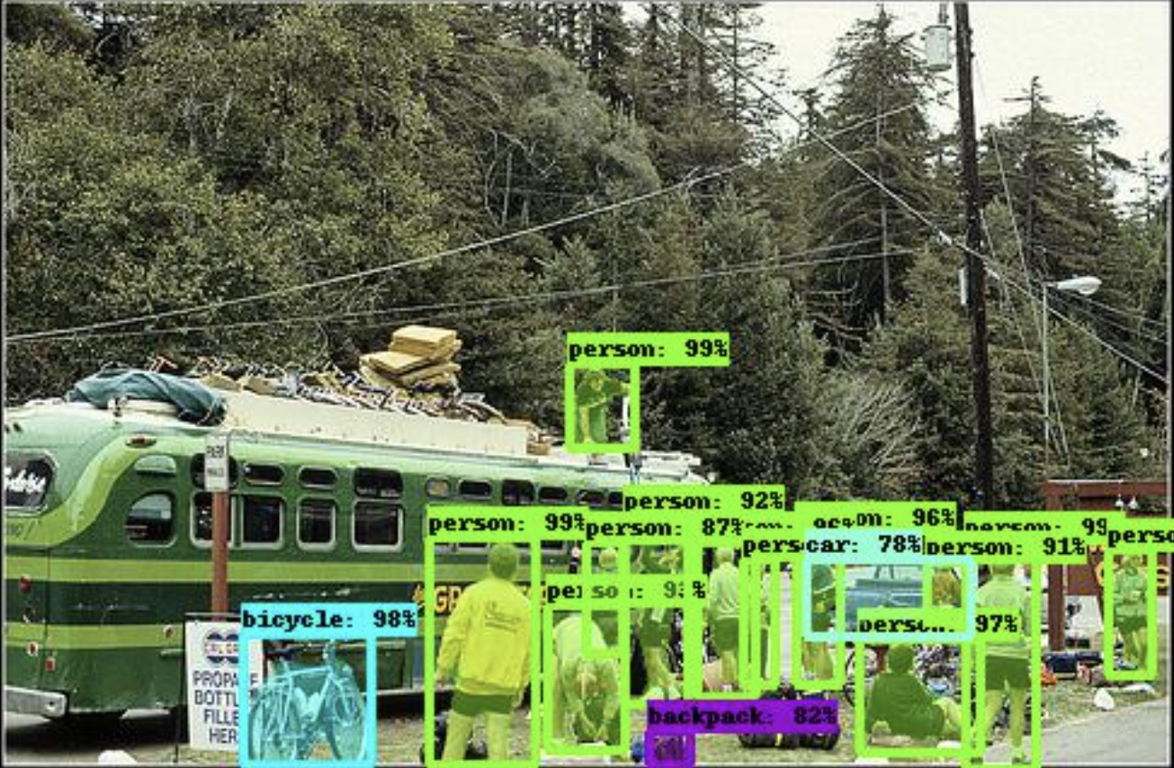
Experiment: Yolo vs Mask-RCNN
Yolo performance
Mask-RCNN performance

Slide 13
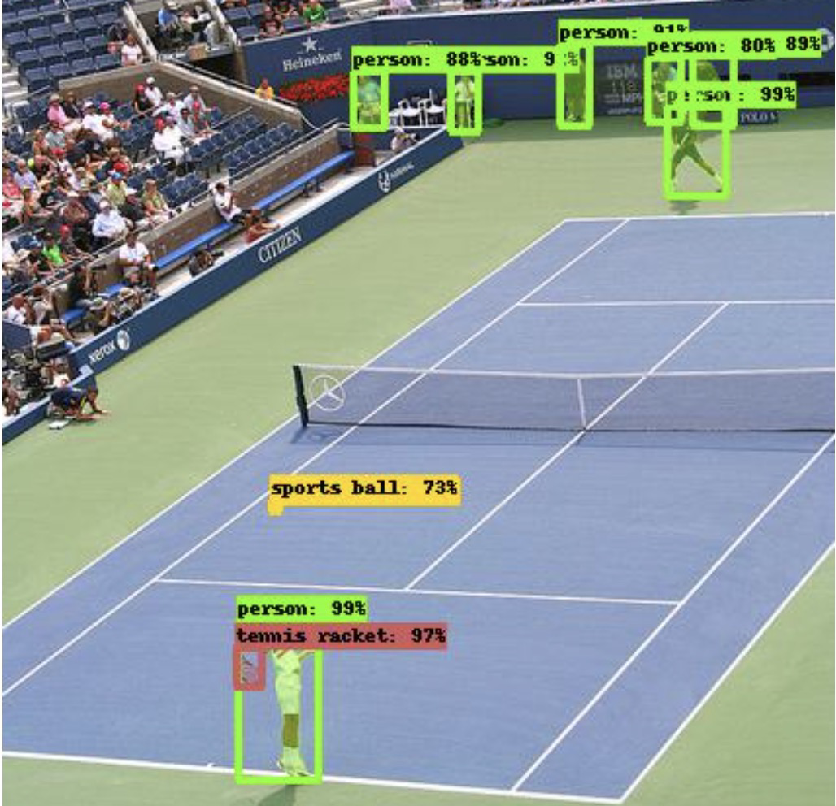
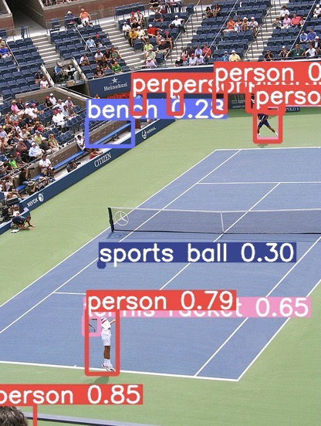
Experiment: Yolo vs Mask-RCNN
Mask-RCNN performance
Yolo performance

Slide 14
Conclusions:
Metric | YOLOv5 | Mask R-CNN
Backbone architecture | CSPDarknet-53 | ResNet
Detection architecture | YOLO (single-stage) | Faster R-CNN (two-stage)
Input size | 640x640 or 1024x1024 | Variable
Training time (hours) | 1.5 (COCO) | 25-30 (COCO)
Memory usage (GPU) | 4.5 GB (640x640) | 5.5 GB (1024x1024)
Performance on Small Objects | Limited | Advanced
Object Accuracy | Lower | Higher
FLOPs | 25.8B(faster) | 213.3B(slower)
Supported frameworks | PyTorch, TensorFlow | TensorFlow,keras

Slide 15
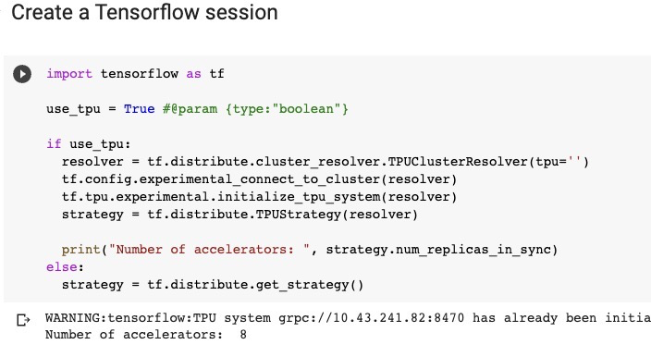
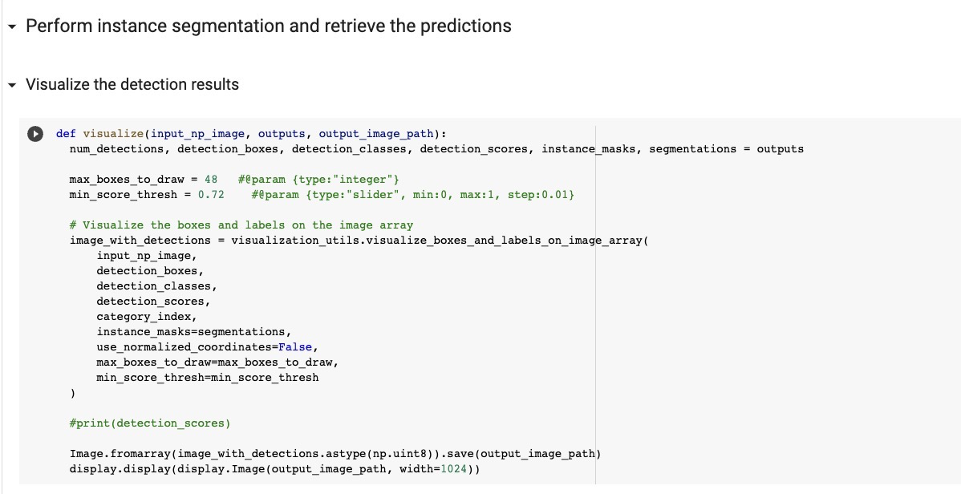
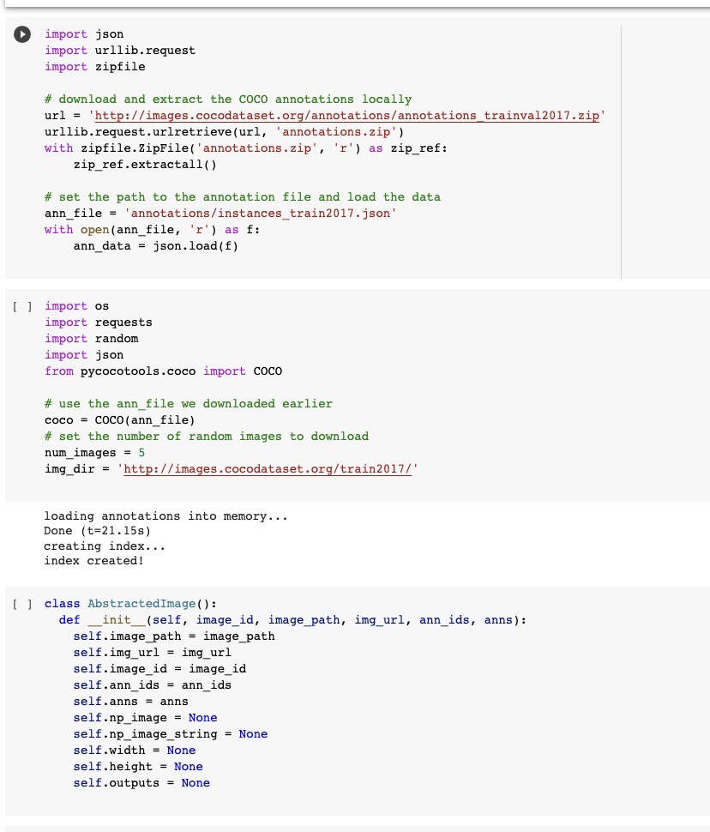
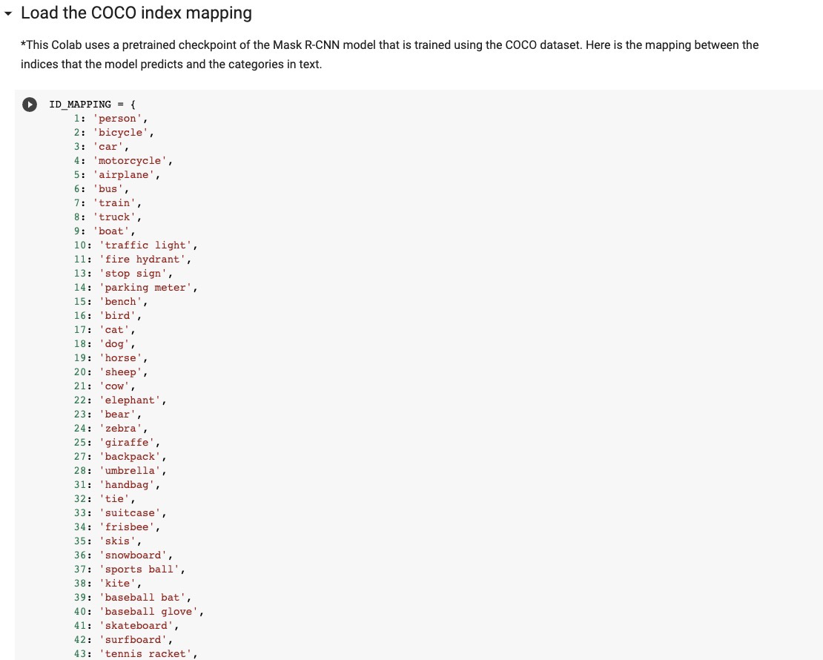
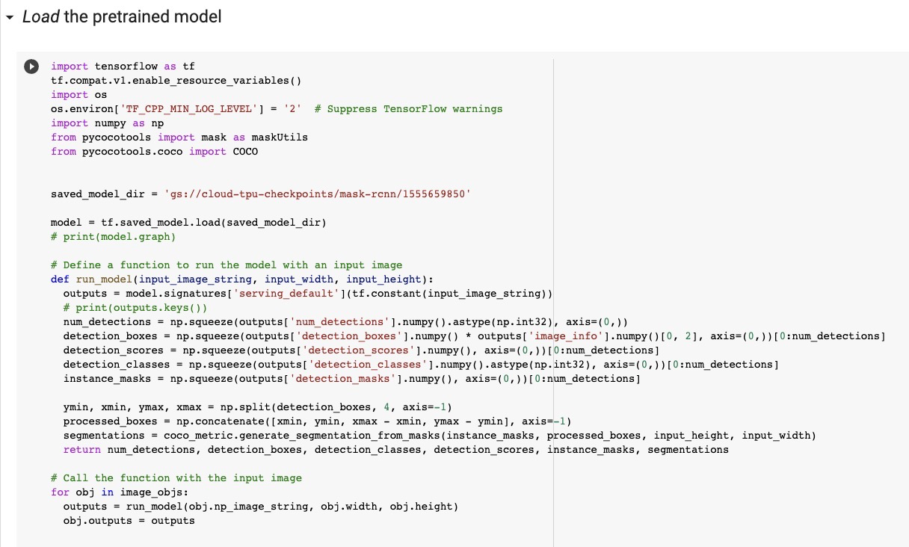
Google collab notebook ::https://colab.research.google.com/drive/1TA3PW-f4bTMoSZPb5wplfP0dHi4SDOCG?usp=sharing

Slide 16
Thank you

